Slide 1
MPI Parallel Programming with the Message Passing Interface
1

Slide 2
The Message-Passing Model
A process is (traditionally) a program counter and address space.
Processes may have multiple threads (program counters and associated stacks) sharing a single address space. MPI is for communication among processes, which have separate address spaces.
Inter process communication consists of
Synchronization
Movement of data from one process’s address space to another’s.
2

Slide 3
Types of Parallel Computing Models
Data Parallel - the same instructions are carried out simultaneously on multiple data items (SIMD)
Task Parallel - different instructions on different data (MIMD)
SPMD (single program, multiple data) not synchronized at individual operation level
SPMD is equivalent to MIMD since each MIMD program can be made SPMD (similarly for SIMD, but not in practical sense.)
Message passing (and MPI) is for MIMD/SPMD parallelism.
3

Slide 4
MPI Sources
The Standard itself:
at http://www.mpi-forum.org
All MPI official releases, in both postscript and HTML
Books:
Using MPI: Portable Parallel Programming with the Message-Passing Interface, by Gropp, Lusk, and Skjellum, MIT Press, 1994.
MPI: The Complete Reference, by Snir, Otto, Huss-Lederman, Walker, and Dongarra, MIT Press, 1996.
Designing and Building Parallel Programs, by Ian Foster, Addison-Wesley, 1995.
Parallel Programming with MPI, by Peter Pacheco, Morgan-Kaufmann, 1997.
MPI: The Complete Reference Vol 1 and 2,MIT Press, 1998(Fall).
Other information on Web:
at http://www.mcs.anl.gov/mpi
pointers to lots of stuff, including other talks and tutorials, a FAQ, other MPI pages
4

Slide 5
Why Use MPI?
MPI provides a powerful, efficient, and portable way to express parallel programs
MPI was explicitly designed to enable libraries…
… which may eliminate the need for many users to learn (much of) MPI
5

Slide 6
A Minimal MPI Program (C)
#include "mpi.h"
#include <stdio.h>
int main( int argc, char *argv[] )
{
MPI_Init( &argc, &argv );
printf( "Hello, world!\n" );
MPI_Finalize();
return 0;
}
6

Slide 7
Notes on C
In C:
mpi.h must be #included
MPI functions return error codes or MPI_SUCCESS
7

Slide 8
Error Handling
By default, an error causes all processes to abort.
The user can cause routines to return (with an error code) instead.
A user can also write and install custom error handlers.
8

Slide 9
Finding Out About the Environment
Two important questions that arise early in a parallel program are:
How many processes are participating in this computation?
Which one am I?
MPI provides functions to answer these questions:
MPI_Comm_size reports the number of processes.
MPI_Comm_rank reports the rank, a number between 0 and size-1, identifying the calling process
9

Slide 10
Better Hello (C)
#include "mpi.h"
#include <stdio.h>
int main( int argc, char *argv[] )
{
int rank, size;
MPI_Init( &argc, &argv );
MPI_Comm_rank( MPI_COMM_WORLD, &rank );
MPI_Comm_size( MPI_COMM_WORLD, &size );
printf( "I am %d of %d\n", rank, size );
MPI_Finalize();
return 0;
}
10

Slide 11
What is message passing?
Data transfer plus synchronization
Process 0
Data
May I Send?
Data
Data
Data
Data
Data
Data
Data
Data
Process 1
Yes
Time
Requires cooperation of sender and receiver
Cooperation not always apparent in code
11

Slide 12
Some Basic Concepts
Processes can be collected into groups.
Each message is sent in a context, and must be received in the same context.
A group and context together form a communicator.
A process is identified by its rank in the group associated with a communicator.
There is a default communicator whose group contains all initial processes, called MPI_COMM_WORLD.
12

Slide 13
MPI Tags
Messages are sent with an accompanying user-defined integer tag, to assist the receiving process in identifying the message.
Messages can be screened at the receiving end by specifying a specific tag, or not screened by specifying MPI_ANY_TAG as the tag in a receive.
Some non-MPI message-passing systems have called tags “message types”. MPI calls them tags to avoid confusion with datatypes.
13

Slide 14
MPI is Simple
Many parallel programs can be written using just these six functions, only two of which are non-trivial:
MPI_INIT
MPI_FINALIZE
MPI_COMM_SIZE
MPI_COMM_RANK
MPI_SEND
MPI_RECV
14

Slide 15
Introduction to Collective Operations in MPI
Collective operations are called by all processes in a communicator.
MPI_BCAST distributes data from one process (the root) to all others in a communicator.
MPI_REDUCE combines data from all processes in communicator and returns it to one process.
In many numerical algorithms, SEND/RECEIVE can be replaced by BCAST/REDUCE, improving both simplicity and efficiency.
15

Slide 16
Blocking: return only when the buffer is ready to be reused.
Non-blocking: return immediately. Buffering: data is kept until it is received.
Synchronization: when a send is completed.
16

Slide 17
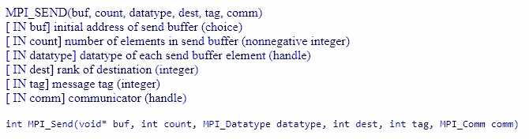
Blocking send
17

Slide 18
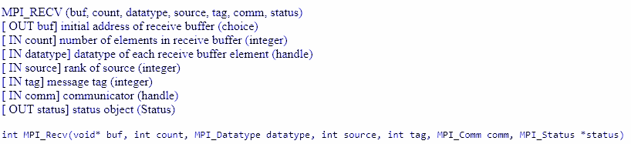
Blocking receive
18

Slide 19
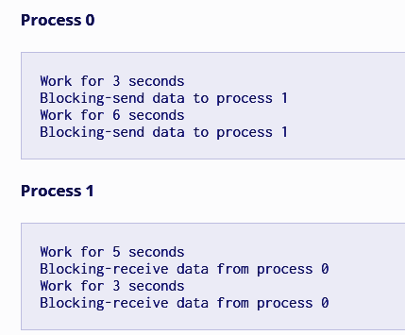

Slide 20
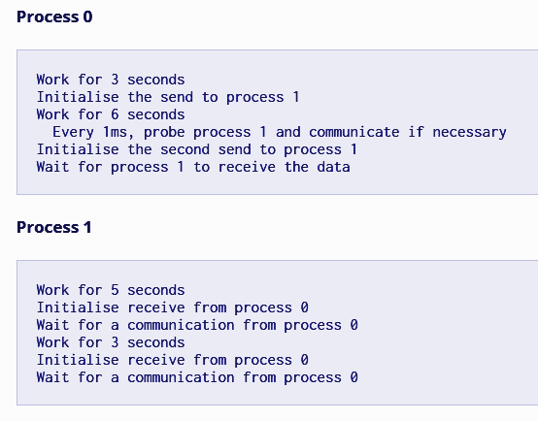

Slide 21
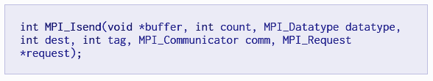
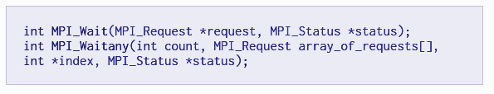
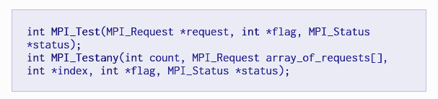
Non Blocking Send
21

Slide 22
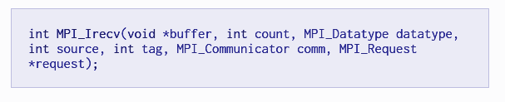
Non Blocking Receive

Slide 23

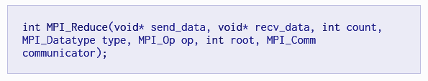
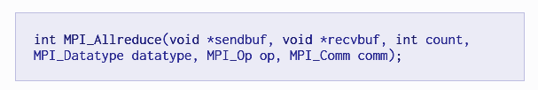
Reduce

Slide 24

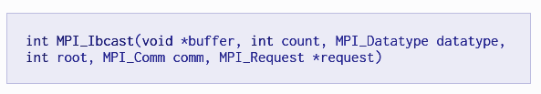
Broadcast

Slide 25
Toward a Portable MPI Environment
MPICH is a high-performance portable implementation of MPI .
It runs on MPP's, clusters, and heterogeneous networks of workstations.
In a wide variety of environments, one can do:
configure
make
mpicc -mpitrace myprog.c
mpirun -np 10 myprog
upshot myprog.log
to build, compile, run, and analyze performance.
25

Slide 26
When to use MPI
Portability and Performance
Irregular Data Structures
Building Tools for Others
Libraries
Need to Manage memory on a per processor basis
26

Slide 27
Summary
The parallel computing community has cooperated on the development of a standard for message-passing libraries.
There are many implementations, on nearly all platforms.
MPI subsets are easy to learn and use.
Lots of MPI material is available.
27

Slide 28
Homework
Study different versions of Reduce and broadcast functions
Study gather and scatter MPI functions

